Slide 1
Python Basics
July 21st, 2019
本週進度:
從零開始學Python (Chapter 11)

Slide 2
異常處理 Exception Handling

Slide 3
try-except
﻿while True:
num = input("Please input an integer: ")
try:
num = int(num)
print(f"{num} % 5 = {num % 5}")
except:
print("ERROR: The input number is NOT an integer.")

Slide 4
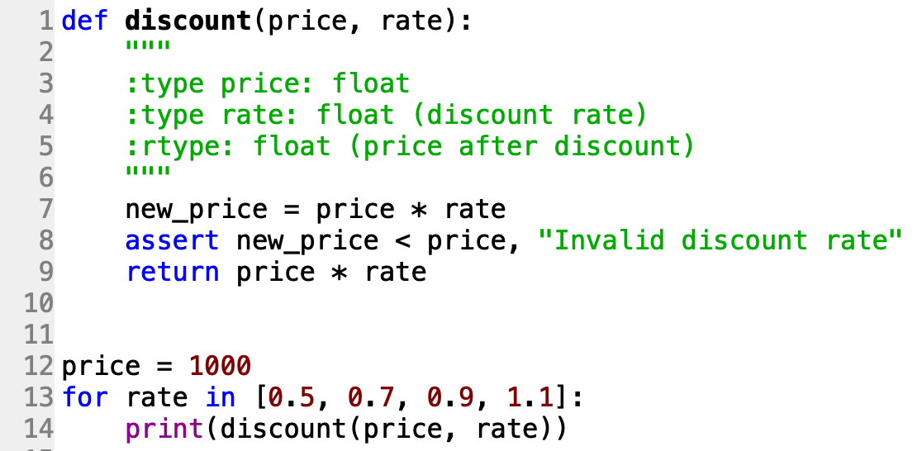
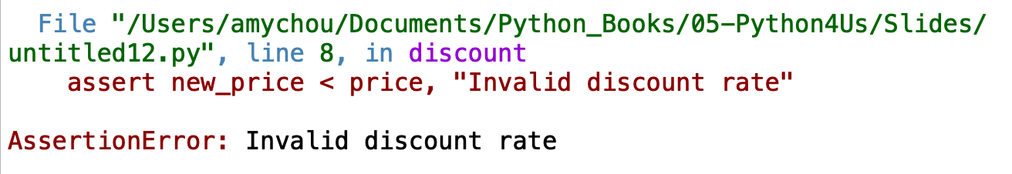
assert

Slide 5
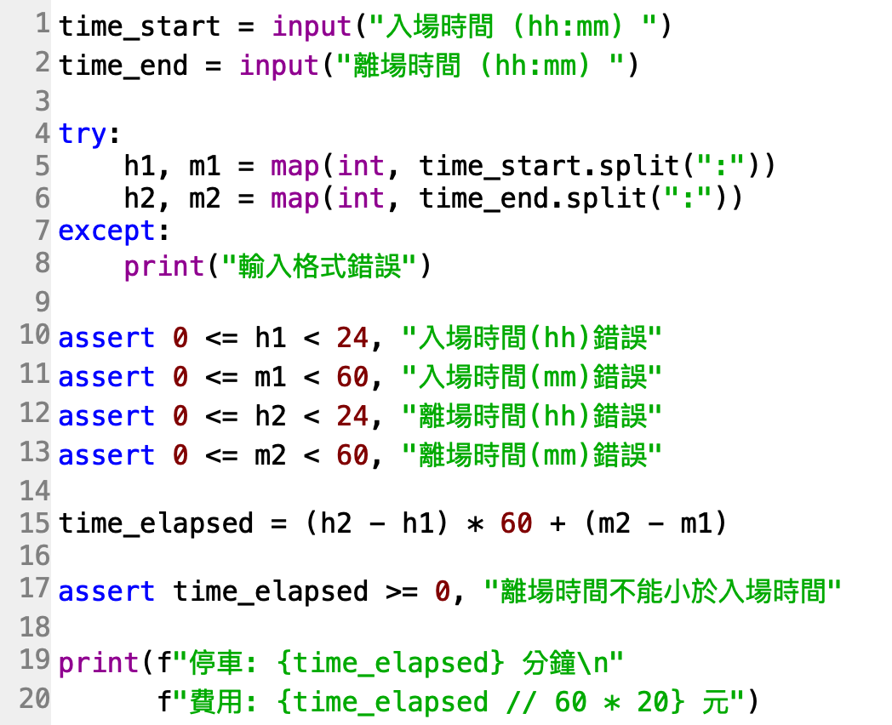
停
車
場
計
費
系
統

